Slide 1

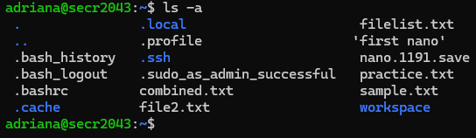
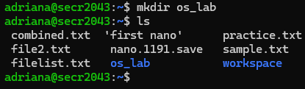

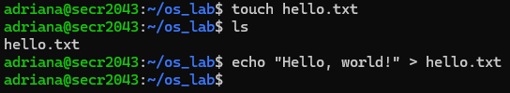
SECR2043 OPERATING SYSTEMS
Name | : NURUL ADRIANA BINTI KAMAL JEFRI | Marks
Student ID | : A23CS0258
Section | : 03
This lab assessment is designed to test your understanding and skills on some basic concepts and tools related to operating system. Please follow the instructions carefully and submit your answers in this word document and rename the file as os-lab-assessment01-studentname-matricno.docx.
ACTIVITY 1 : | BASIC LINUX COMMANDS
In this activity, you will practice some basic Linux commands that are useful for operating system tasks. For each question, write down the command you used and the output you got in your answer file. If the command does not produce any output, write "No output" instead.
1. | Display your current working directory.
 | Command | Output
 | pwd
2. | List all the files and directories in your home directory, including hidden ones.
 | Command | Output
 | ls -a
3. | Create a new directory named "os_lab" in your home directory.
 | Command | Output
 | mkdir os_lab ls
4. | Change your current working directory to "os_lab".
 | Command | Output
 | cd os_lab
5. | Create a new file named "hello.txt" in "os_lab" and write "Hello, world!" in it.
 | Command | Output
 | touch hello.txt ls echo “Hello, world!” > hello.txt

Slide 2




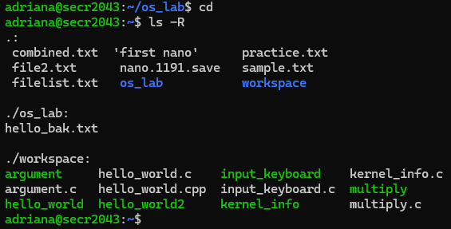
6. | Display the content of "hello.txt".
 | Command | Output
 | cat hello.txt
7. | Copy "hello.txt" to another file named "hello_copy.txt" in the same directory.
 | Command | Output
 | cp hello.txt hello_copy.txt cat hello_copy.txt
8. | Rename "hello_copy.txt" to "hello_bak.txt".
 | Command | Output
 | mv hello_copy.txt hello_bak.txt cat hello_bak.txt
9. | Delete "hello.txt".
 | Command | Output
 | rm hello.txt ls
10. | Display your home directory with additional information, together with subdirectories contents.
 | Command | Output
 | cd ls -R
 | Total Mark:

Slide 3
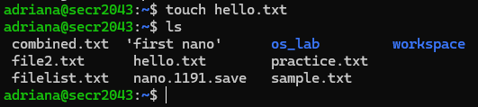






ACTIVITY 2 : | Text File Manipulation
In this activity, you will practice some commands to create and manipulate text files using echo, cat and touch.
For each question, write down the command and the output (if any) in the answer sheet.
1. | Create an empty file named "hello.txt" in the current working directory.
 | Command | Output
 | touch hello.txt ls
2. | Write the text "Hello World" to "hello.txt" using echo.
 | Command | Output
 | echo "Hello World!" > hello.txt cat hello.txt
3. | Append the text "This is a test" to "hello.txt" using echo.
 | Command | Output
 | echo "This is a test" >> hello.txt cat hello.txt
4. | Display the contents of "hello.txt" using cat.
 | Command | Output
 | cat hello.txt
5. | Create another file named "bye.txt" with the text "Goodbye World" using echo.
 | Command | Output
 | touch bye.txt echo "Goodbye World" > bye.txt
6. | Concatenate the contents of "hello.txt" and "bye.txt" and display them using cat.
 | Command | Output
 | cat hello.txt bye.txt
7. | Concatenate the contents of "hello.txt" and "bye.txt" and write them to a new file named "greeting.txt" using cat.
 | Command | Output
 | cat hello.txt bye.txt > greeting.txt

Slide 4



8. | Display the contents of "greeting.txt" using cat.
 | Command | Output
 | cat greeting.txt
9. | Edit the file "greeting.txt" using Nano and change the word "World" to your name in both lines.
 | Command | Output
 | nano greeting.txt
10. | Display the modified contents of "greeting.txt" using cat.
 | Command | Output
 | cat greeting.txt
 | Total Mark:

Slide 5
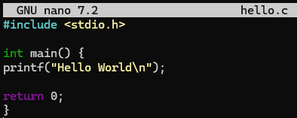


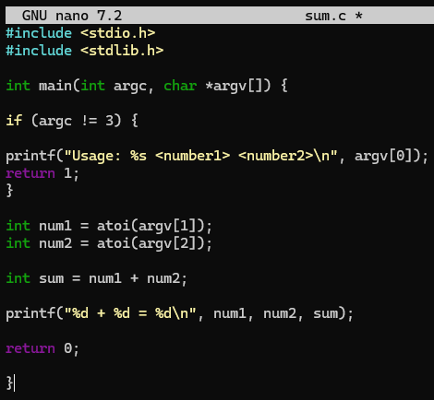


ACTIVITY 3 : | WRITE, COMPILE AND RUN C PROGRAM
In this activity, you will practice how to write, compile and run a simple C program using gcc. For each question, write down the command and the output (if any) in the answer sheet.
1. | Write a C program that prints "Hello World" to the standard output using Nano and save it as "hello.c".
 | Command | Output
 | nano hello.c
2. | Compile the program "hello.c" using gcc and generate an executable file named "hello".
 | Command | Output
 | gcc hello..c –o hello
3. | Run the executable file "hello" and display its output.
 | Command | Output
 | ./hello
4. | Write a C program that takes two integers as command line arguments and prints their sum to the standard output using Nano and save it as "sum.c".
 | Command | Output
 | nano sum.c
5. | Compile the program "sum.c" using gcc and generate an executable file named "sum".
 | Command | Output
 | gcc sum.c –o sum
6. | Run the executable file "sum" with 10 and 20 as arguments and display its output.
 | Command | Output
 | ./sum 10 20

Slide 6

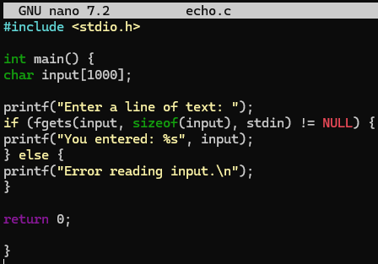


7. | Run the executable file "sum" with -5 and 15 as arguments and display its output.
 | Command | Output
 | ./sum -5 15
8. | Write a C program that reads a line of text from the standard input and prints it to the standard output using Nano and save it as "echo.c".
 | Command | Output
 | nano echo.c
9. | Compile the program "echo.c" using gcc and generate an executable file named "echo".
 | Command | Output
 | gcc echo.c –o echo
10. | Run the executable file "echo", type "Hello World" as input and display its output.
 | Command | Output
 | ./echo
 | Total Mark:

